Slide 1
Handwritten Digit Recognition Using KNN and Naive Bayes
Muddasar Razzaq
Information Tech Consultants
A comparison of KNN and Naive Bayes classifiers on the MNIST dataset.

Slide 2
Objective and Dataset
Objective: Build a model to recognize handwritten digits.
Dataset: MNIST (60,000 training, 10,000 testing images).
Each image is 28x28 pixels converted to 784 features.
Steps: Data cleaning, normalization, and splitting.

Slide 3
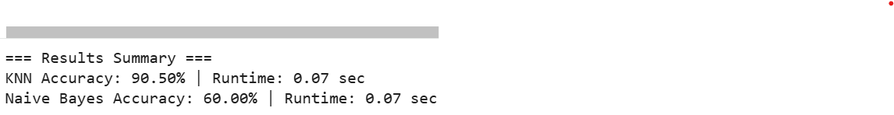
KNN Implementation
Concept: Classifies samples using k nearest neighbors.
Distance: Euclidean.
Results:
- Accuracy: ~80%
- Runtime: ~60 sec
Pros: High accuracy.
Cons: Computationally expensive.

Slide 4
Naive Bayes Implementation
Concept: Probabilistic model assuming independent features.
Formula: P(y|X) ∝ P(y) ∏ P(xi|y)
Results:
- Accuracy: ~60%
- Runtime: ~2 sec
Pros: Very fast.
Cons: Lower accuracy.

Slide 5
Comparison Table
Model | Accuracy | Runtime | Notes
------|-----------|----------|--------------------
KNN | 80% | ~60 sec | More accurate, slower
Naive Bayes | 60% | ~2 sec | Fast, less accurate

Slide 6
Confusion Matrices
KNN Confusion Matrix (strong diagonal)
Naive Bayes Confusion Matrix (more spread)
Diagonal = correct predictions
Off-diagonal = misclassifications

Slide 7
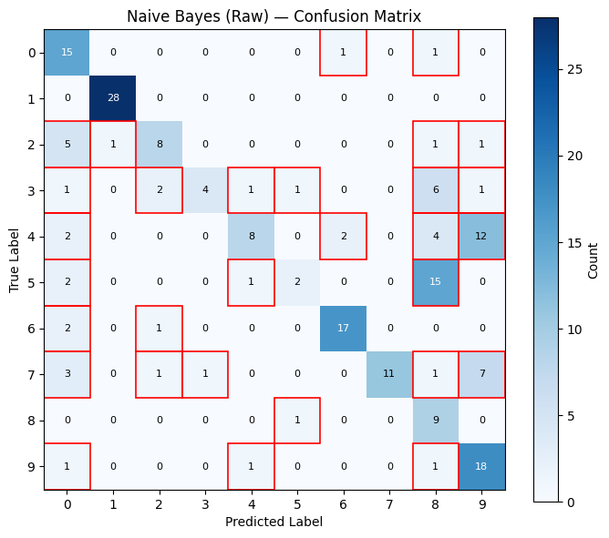

Slide 8
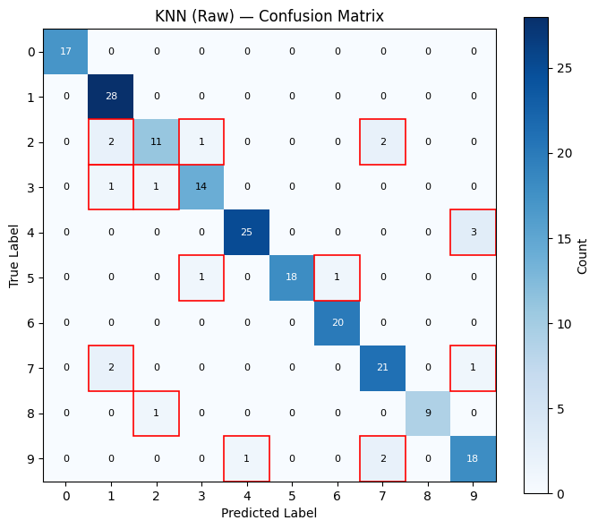

Slide 9
Key Insights
• KNN: High accuracy, slower.
• Naive Bayes: Fast, less accurate.
• Both useful for learning classic ML.
Takeaway: KNN performs better overall on MNIST.

Slide 10
Conclusion
• Both models implemented without scikit-learn.
• Demonstrates power of normalization and clean data.
• Future work: explore neural networks for better accuracy.

Slide 11
Acknowledgments
Project by: Muddasar Razzaq
Organization: Information Tech Consultants
Tools: Python, NumPy, Pandas, Matplotlib, Google Colab
Dataset: MNIST

